Slide 1
Master-Slave
Robotic Arm for Ball Manipulation
-Critical Design Review-
Ethan Barlow, Chase Call, Hudson Hiatt, and Parker Bentley
Notes:
[Chase]
Welcome to our Critical Design Review. Our senior project is to create a master-slave robotic arm for manipulating a ball.

Slide 2
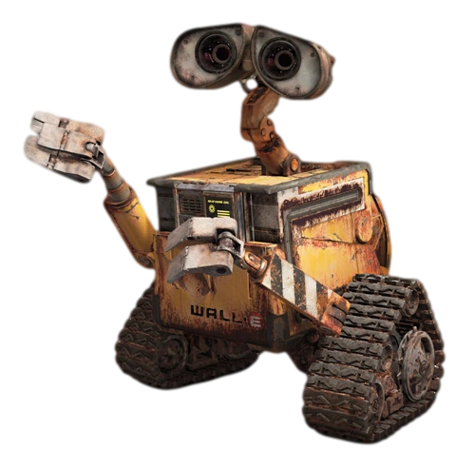
Project Statement
Create a robotic platform that can manipulate a ball.
Notes:
[Parker]
The task we were given was to create a robotic platform that could manipulate and toss a ball. Which can be done a variety of ways.

Slide 3
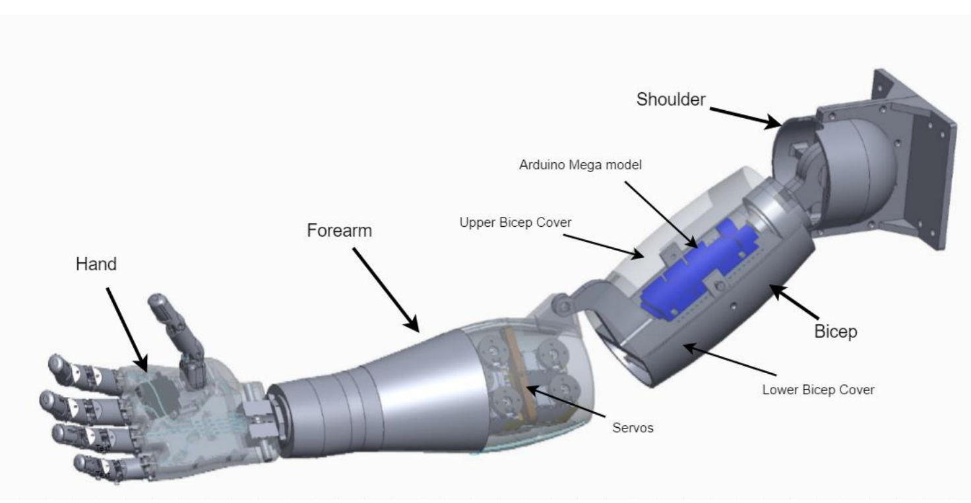
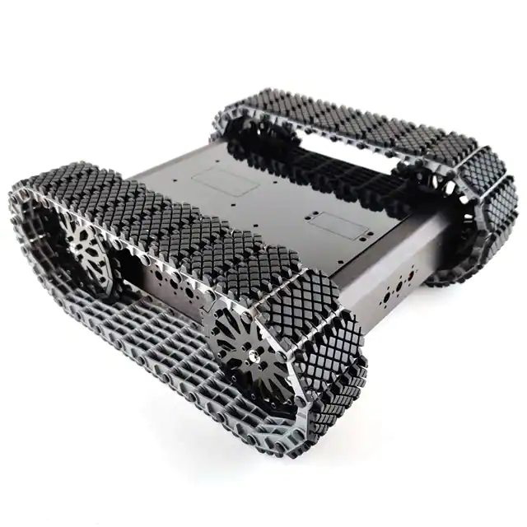
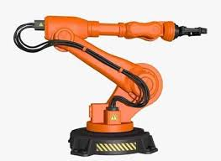
Preliminary Design
Robot
Arm & Linkages
Basic Build?
Basket/
Carriage
Notes:
[Parker]
We began brainstorming anything and everything, no idea was left out. The first designs we considered were the basic build of what the robot would look like. We could go with some kind of robotic arm made of linkages, or we could make some kind of belt driven system with a basket/carriage/platform that would catch the ball.

Slide 4
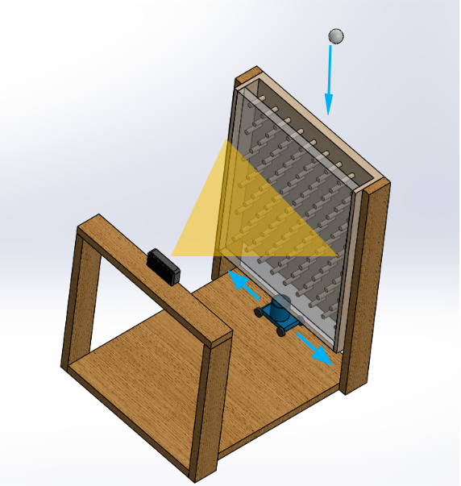
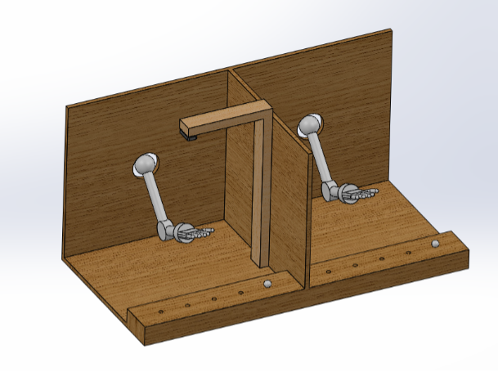
Basic Build Design
Parameters | Arm | Basket
Cost | 2 | 3
Manufacturability | 4 | 3
Versatility | 1 | 3
Intrigue | 1 | 2
Difficulty | 4 | 5
Total | 12 | 16
Arm & Linkages
Basket/Carriage
More design freedom.
Teleoperation is fascinating.
Too complex. Requires computer vision.
Cannot throw the ball.
Notes:
[Parker]
So with these two ideas in mind we came up with a few concepts and drew them up in CAD.
The first idea was to have a robotic arm mounted to a wooden frame and on the other side a human arm.
The idea being that we would mount an OAK-D camera on the human side, grab a ball and move it to one of the receptacles shown on the front of the board, while doing this the Oak-D would track our movements while also communicating with the robotic arm, ideally replicating the humans movement and ultimately placing the ball where it should go.
As for the basket, we came up with using a plinko board with a transparent sheet of glass on one side.
And after placing a ping pong ball in the top, the ball will jump around somewhat sporadically while an OAK-D camera equipped with computer vision attempts to track the ball while also directing a carriage on a line rail where the basket will attempt to intercept the ball.
Using a robotic arm with multiple linkages offered us a lot flexibility when designing. It also invited the idea of teleoperation. Which is using a robot to perform tasks with a human as the operator. We delve into this in more detail later.
This concept was interesting, but mostly involved training our own A.I., which we felt was too outside our knowledge base to accomplish at this time.
We made a design matrix to effectively rank the two designs according to 5 parameters. Each parameter was ranked on a scale from 1 to 5, the lower the number the better. The five parameters we used were:
cost,
Manufacturability, which is the Degree a product can be effectively manufactured.
Versatility which we defined as the Adaptability of the design, and how customizable the design is.
Intrigue the only subjective parameter was measured by how exciting we thought the design would be.
and lastly, the difficulty of the project.
The arm build won out overall, so we decided to move in that direction.

Slide 5
Preliminary Design
Robot
Arm & Linkages
Humanoid
Basic Build?
Arm Type?
Basket/
Carriage
Articulated
Notes:
[Parker]
After making our decision we needed to decide what type of robotic arm we wanted. The two we chose were humanoid and articulated.

Slide 6
Arm Design
Parameters | Humanoid | Articulated
Cost | 1 | 5
Manufacturability | 4 | 1
Versatility | 2 | 4
Intrigue | 1 | 2
Difficulty | 4 | 3
Total | 12 | 15
Humanoid
Articulated
Open-source designs available.
Very complex but customizable.
Challenging and interesting.
More realistically replicates operator actions.
Industrial ones are too expensive.
Small kit ones are too weak and not customizable for end-effectors.
Notes:
[Parker]
So we compared these two designs just as we did with the basic build. There are actually a number of open-source designs for humanoid robots on the internet, such as the InMoov robot.
All of the CAD models for the InMoov parts are free on the internet and can be 3D printed. They can be enormously complex, but ultimately the idea was very compelling and we were all excited to work on something like that
A humanoid arm is also a much more realistic mechanism for replicating tossing and catching a ball. On the other hand, we have articulated robots.
So these are by far the most common type of robot.
But all of the industrial grade ones are far too expensive, build-your-own kits are available for purchase but are too weak and lack the customizable capabilities we need to change the end-effector.
Using our design matrix rated each of these two and concluded that the humanoid concept was the one we wanted to pursue.

Slide 7
Preliminary Design
Robot
Arm & Linkages
Humanoid
Data Glove
Basic Build?
Arm Type?
Input?
Basket/
Carriage
Articulated
OAK-D Camera
Notes:
[Chase]
So now our design tree looked like this. The next decision to make was how we were going to collect usable input for teleoperation. The two ideas we considered were a data glove, which is quite similar to a haptic glove, only without the tactile feedback. Versus an OAK-D camera as previously mentioned.

Slide 8
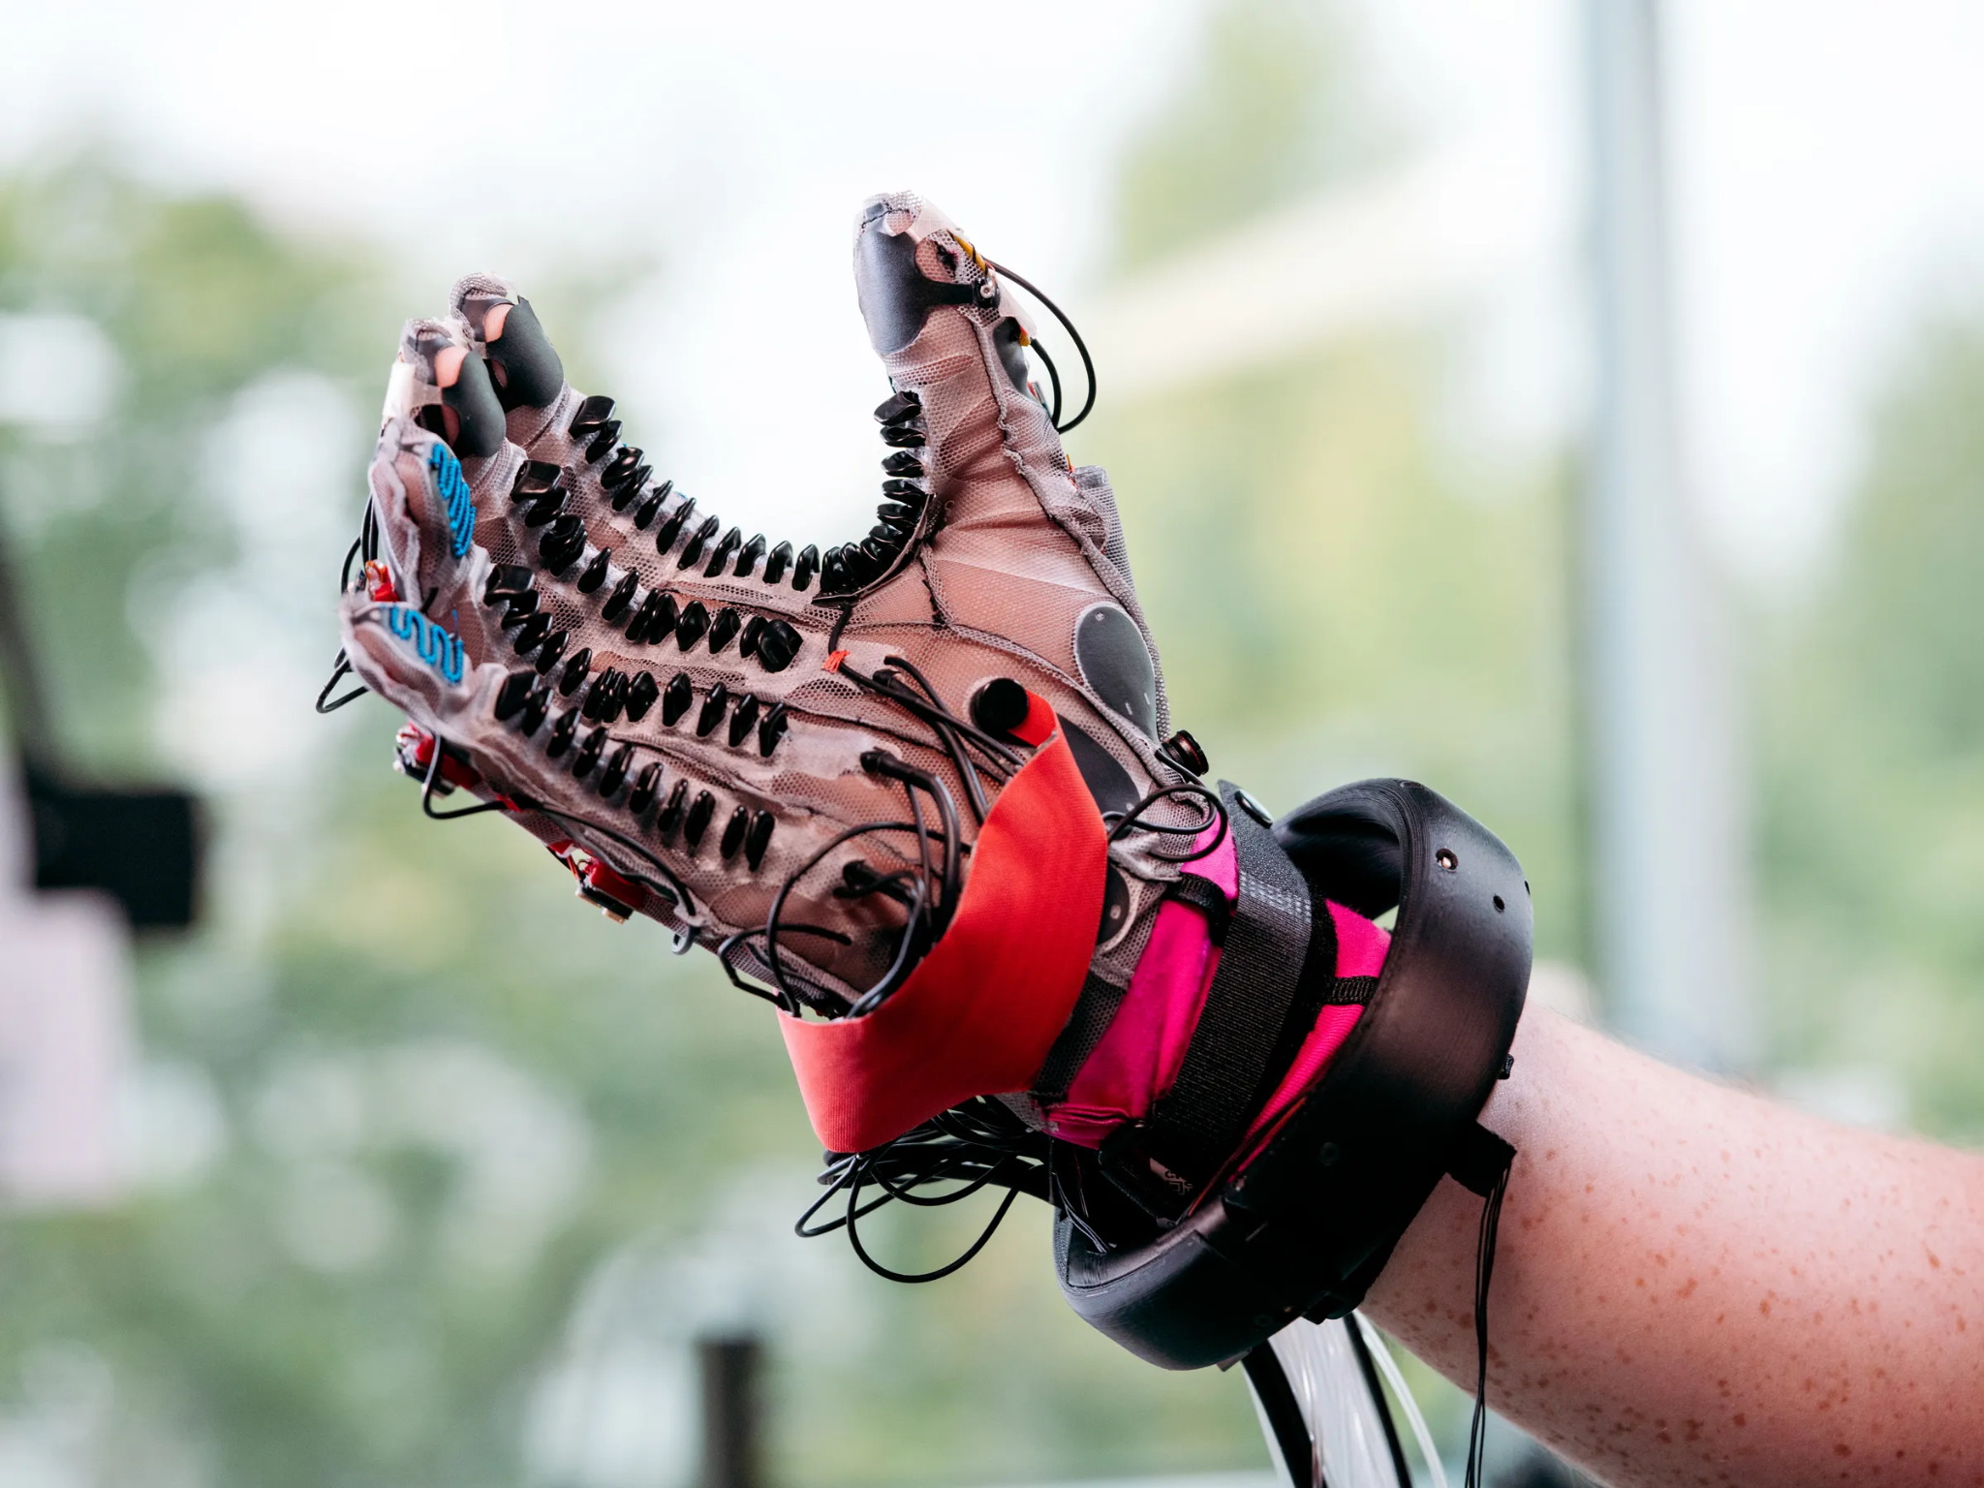
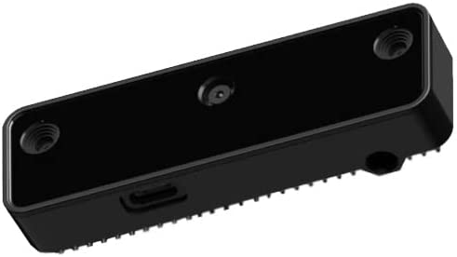
Input Design
Parameters | Data Glove | Camera
Cost | 2 | 3
Manufacturability | 4 | 2
Versatility | 2 | 4
Intrigue | 1 | 2
Difficulty | 4 | 5
Total | 13 | 16
Data Glove
OAK-D Camera
3D printable but time intensive.
Very exciting.
Challenging but doable with current knowledge.
Training A.I. too complex for our level.
Not able to track hand when wrist turns.
Notes:
[Chase]
So once again, the OAK-D was still too complex for this application. We also did not have a way for the camera to track the hand pose in space when the wrist turns. However, a data glove can be created quite easily with minimal 3d printing, wiring, and soldering. We found the data glove concept to be challenging, but doable with our current knowledge. We rated these as well and the data glove won.

Slide 9
Preliminary Design
Robot
Arm & Linkages
Humanoid
Data Glove
Raspberry Pi
Basic Build?
Arm Type?
Input?
Microcontroller?
Basket/
Carriage
Articulated
OAK-D Camera
Arduino
Notes:
[Chase]
So now that we decided how we would collect input, the next step was to pick out a brain. Which microcontroller was better for this application? A raspberry pi or arduino?

Slide 10
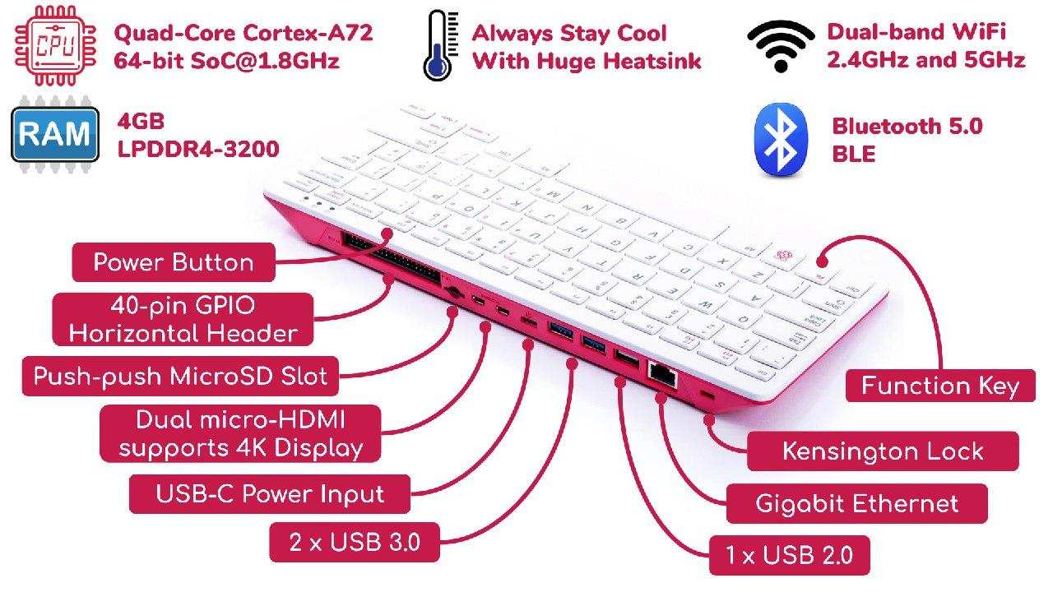
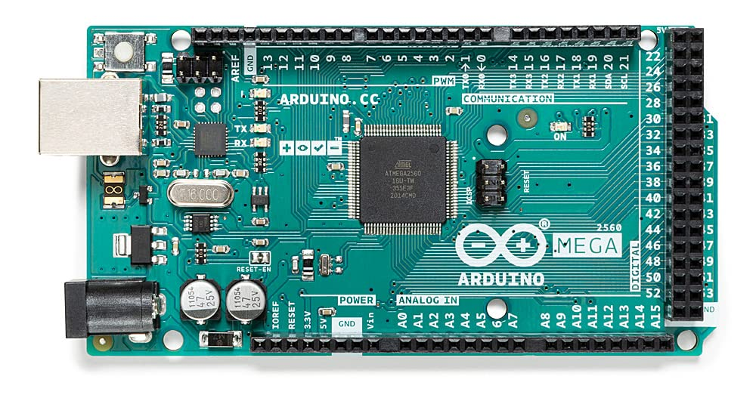
Microcontroller Design
Parameters | Raspberry Pi | Arduino
Cost | 4 | 2
Manufacturability | 1 | 2
Versatility | 1 | 3
Intrigue | 1 | 2
Difficulty | 3 | 3
Total | 10 | 12
Raspberry Pi 400
Arduino Mega/Uno
Very powerful processor.
Doesn’t require separate computer.
Compatible w/ Spyder, Python, and MyRobotLab.
Ergonomic and simple.
Contains plenty of ports for convenience.
Less powerful.
Might require multiple, interconnected arduinos.
Requires arduino language (C-based, which we are less familiar with).
Notes:
[Ethan]
So there are actually multiple versions of each of these processors. They vary quite a bit in size, power, and shape. We decided to go with the Raspberry Pi 400. This unit is actually built into this keyboard with input/output pins on the back and ports for usb, hdmi, ethernet and others. Raspberry Pis are fascinating because they are basically their own mini computers. You don’t have to connect it to a laptop to fire it up. You just have to hook up a computer monitor and mouse because a pi has its operating system. The 400 especially is very powerful. There’s videos on youtube of people using these to play minecraft and first-person shooters. The pi is also an excellent choice because it is compatible with spyder ide, python, and myrobotlab. These are all incredibly useful for our project. The arduino on the hand uses its own language that’s C-based, which all of us are less experienced with than python.

Slide 11
Preliminary Design
Robot
Arm & Linkages
Humanoid
Data Glove
Raspberry Pi
Flex Sensor
Basic Build?
Arm Type?
Input?
Microcontroller?
Glove Type?
Basket/
Carriage
Articulated
OAK-D Camera
Arduino
Potentiometer
Notes:
[Ethan]
The last major decision we need to make is what kind of data glove we will make. There are two promising concepts for data gloves and we have decided to hold off on picking one until we can build a prototype of each and test them experimentally.

Slide 12
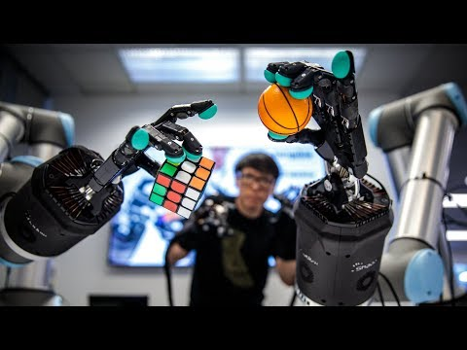
Teleoperation
Shadow Robot
Notes:
[Ethan]
So what IS teleoperation? Well here’s a video of a product called the Shadow robot that is on the market right now. So you can see this man is wearing haptic gloves and the robotic hands are mimicking his actions as he’s doing them. [Watch for maybe 1 min.] On a more crude level, this is basically the method we want to use for our project.

Slide 13
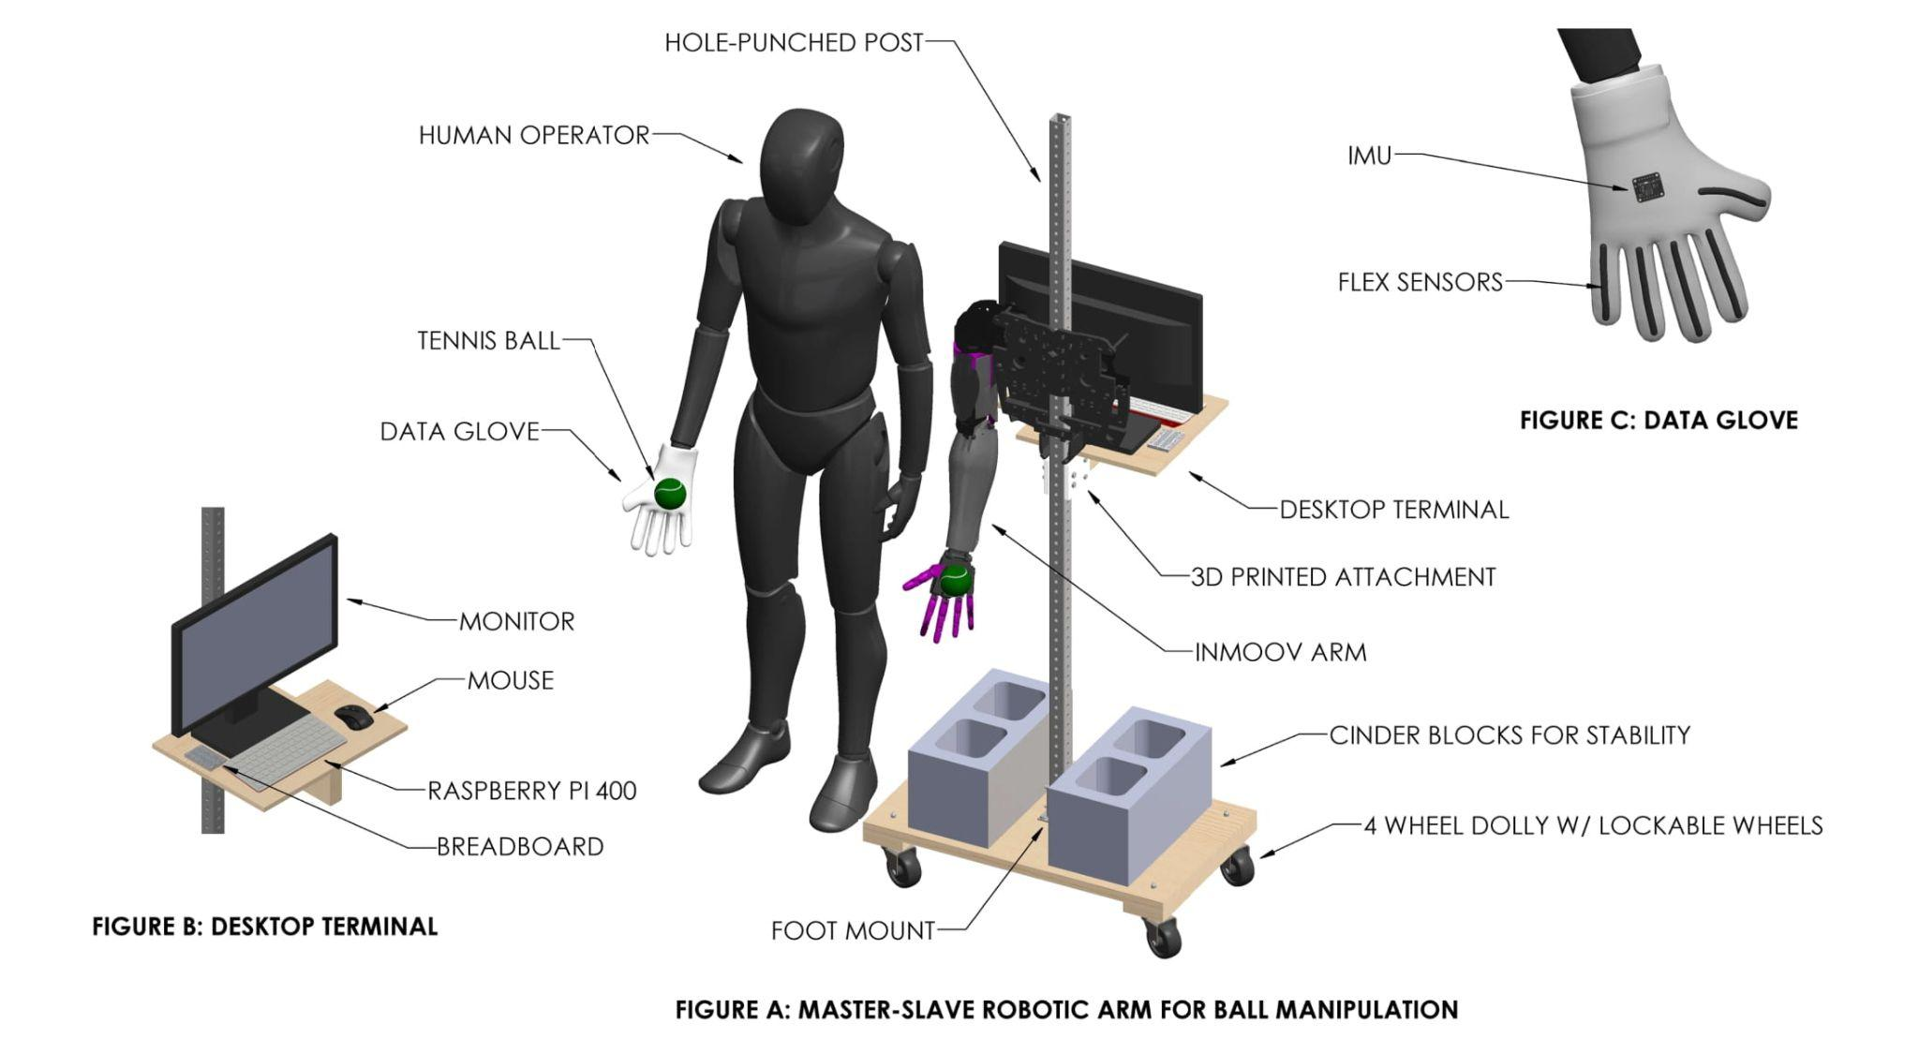
Design/Schematic
Notes:
[Ethan]
So here’s a CAD drawing we created to showcase our design. Figure A in the middle is a complete assembly of our project, and figures B and C are cropped views of the same assembly from different angles. So basically we are going to have metal stand mounted on top of a 4 wheel dolly so it is transportable. The wheels will be lockable, so the stand can be fixed in place when needed. Attached to the stand is the arm of the open-source InMoov robot. Standing adjacent to the inmoov will be a person wearing a data glove. As you can see in the picture, both the person and arm are at the verge of grasping a falling tennis ball in tandem. There are cinder blocks placed on the dolly at the base for stability. You can also see a desktop that will be attached to the post on the backside of the InMoov. This is where all of the electronics, the breadboard, the raspberry pi, the monitor, and the mouse will be located. This will serve as sort of a terminal for programming and accessing the brain of the robot. If you look up at figure C in the top right, you will see the backside of the data glove. This showcases the flex sensor concept. So a flexible resistor will be sewn along each finger and will deform when flexed. The deformation affect the signal traveling through the sensor which comes back to the raspberry pi as an input. Also in the center of the glove is an inertial measurement unit, also called an IMU. The IMU will track the track the position and orientation of the hand in 3D space and will also be relayed back to the raspberry pi as input.

Slide 14
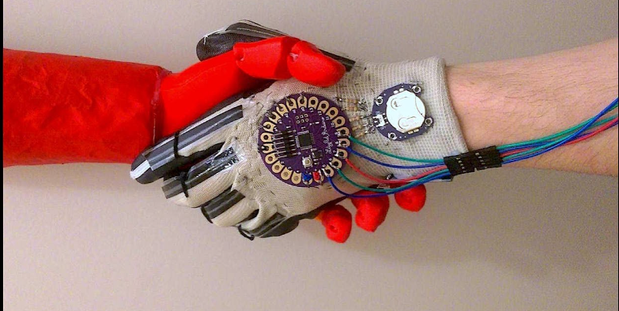
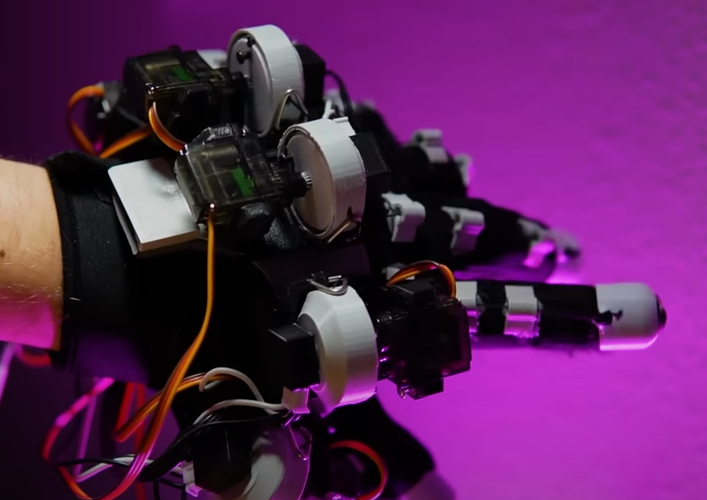
Input: Data Glove (“Master”)
Flex Sensor Glove
Potentiometer Glove
Flex sensors stitched to glove
Soldering
Sleek design
End-Effector Input: deformation of flex sensor (finger rotation)
Spatial Coordinate Input: Inertial measurement unit collects spatial coordinates of palm
Potentiometers attached to fingers via cables/wire
3D printing
Bulky design
End-Effector Input: rotation of potentiometers (finger rotation translated via cables)
Spatial Coordinate Input: Meta Quest 2 VR handheld tracks palm orientation (possible retrofit w/ IMU)
Notes:
[Ethan]
So the flex sensor uses these flexible resistors that when they deform, change the signal passing through. That can be used measure the finger rotation if sewn onto a glove. You can then put an inertial measurement unit on the back of the palm, which will track the position and orientation of the glove in 3D space. The potentiometer glove glove collects spatial coordinates the same way using an IMU or a VR controller. However, the finger rotation inputs are collected by pulling on a cable that is in tension. The cable is attached to a potentiometer and spins when the finger is moved. Both of these gloves can be used to collect two input sources: the end-effector and the spatial coordinate.

Slide 15
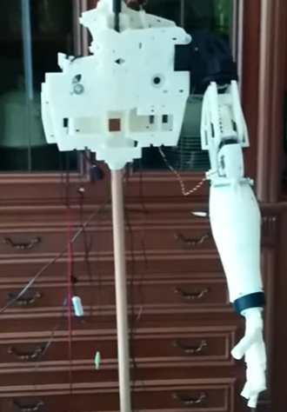
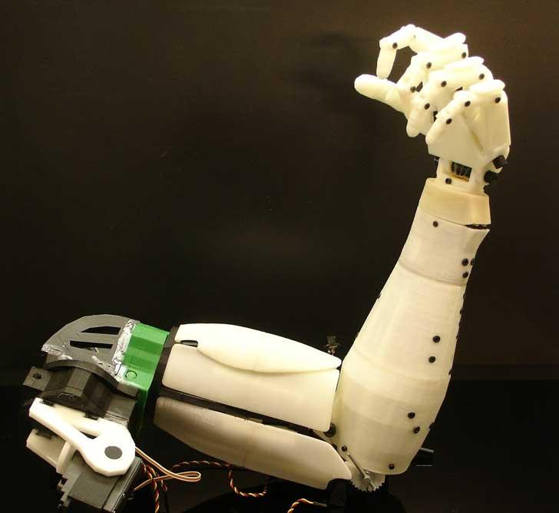
Output: InMoov Arm (“Slave”)
InMoov open-source 3D printable, programmable arm
Only need torso frame and shoulder down
Anchor unit by mounting on stand like shown
5 degrees of freedom (center of palm is “end-effector”)
Master-Slave control
“Master” input from haptic glove (palm coordinates and finger rotations)
“Slave” output to inmoov servos
End-effector actuated directly from input to glove
Palm positioned via inverse kinematics
1 Revolute
1 Revolute
3 Revolute
Notes:
[Ethan]

Slide 16
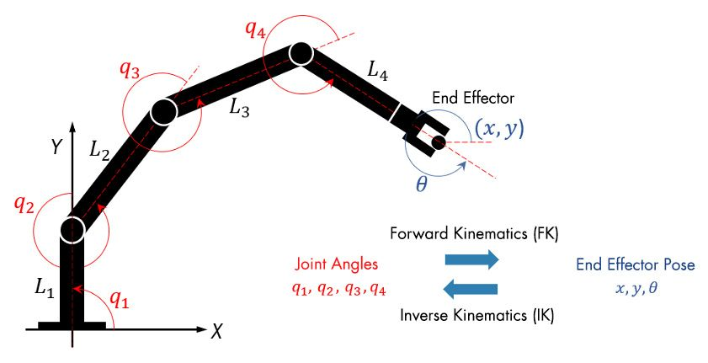
Inverse Kinematics
Notes:
[Ethan]
Solving for the finger rotations is fairly straightforward, but the tricky part is solving for the spatial coordinates of the IMU. To do this, we will use inverse kinematics and software from the MyRobotLab library.

Slide 17
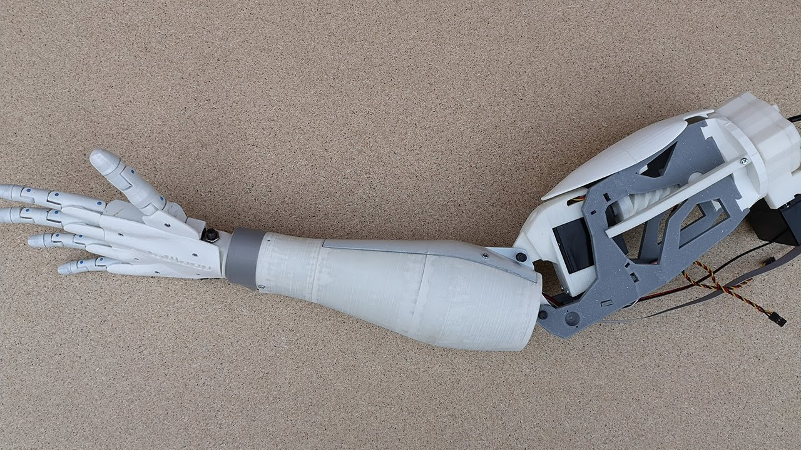
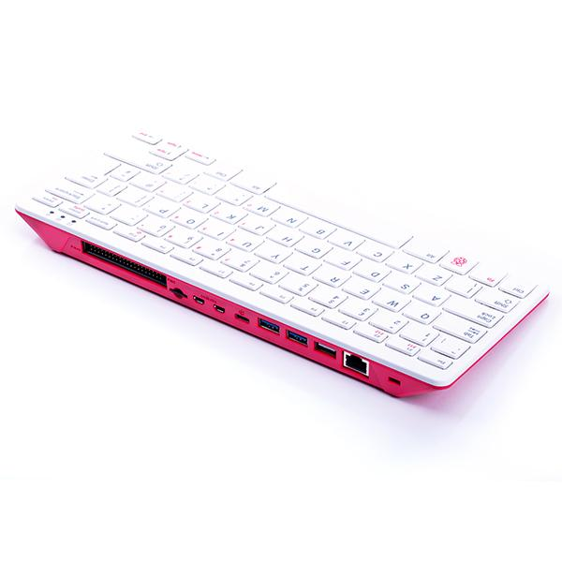
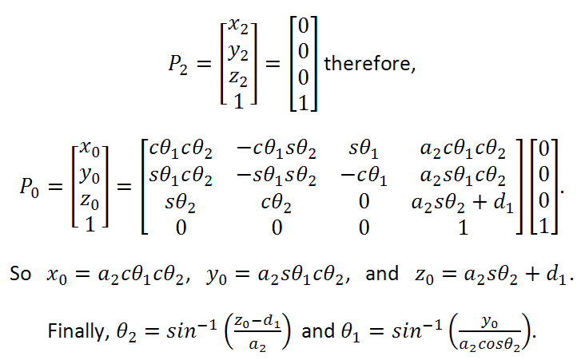
Robot Control
Output 1:
Finger Servos
Input 1: Finger Rotations
Output 2:
Elbow Servo
Data
Glove
Raspberry PI 4000
MyRobotLab/
Inverse Kinematics
Output 3:
Shoulder Servos
Input 2:
Palm 3D Coordinates
Output 4:
Wrist
Servo
Notes:
[Chase]
The control process looks something like this. THe data glove collects input from the the finger rotations and palm coordinates. It then sends that data to the raspberry pi. The raspberry pi will use input one to control the finger servos at output 1. Simultaneously, the pi will use inverse kinematics to control the output of the elbow, shoulder, and wrist servos.

Slide 18
Objectives and Goals
Control fingers of robotic arm using data glove.
Control wrist/bicep/shoulder movement in space.
Pickup a ball that is at rest using master-slave manipulation.
Throw and balance ball.
Notes:
[Hudson]
So these are the objectives we established for our project. The first is that we want to control the fingers of the robotic arm using a data glove. Next we want to control the movement of the wrist, bicep, and shoulder in space. Third is we want to grasp a ball that is at rest using master-slave manipulation. Finally, we want to throw and balance a ball.

Slide 19
Design Challenges
Fabrication:
3D prints likely to fail/troubleshooting.
How do you bond PETG?
Addressing tolerance inconsistencies in plastic parts.
Inverse kinematics:
How do we avoid singularities with a 5 DOF robot?
How do we compute arm positioning in real time?
Control:
Latency: How do we minimize delay between operator and robot action?
Synchronization: How do we sync arm to glove? Do we need a reset/ “home” feature?
Instrumentation: How do we minimize “drift” in IMU measurements?
Programming:
Likely challenges in using MyRobotLab.
Most likely LOTS of coding & bugs to resolve.
Notes:
[Hudson]

Slide 20
Robotic Standards - ISO/TS 15066:2016
5.5.2.2 Robot Motion Requirement
Motion of the robot should be able to be manually stopped by operator if necessary.
Motion of the robot should be halted by powering off the device.
5.3 Design of the collaborative workspace
Design of collaborative workspace shall be such that the operator can perform all intended tasks.
Any risk introduced by robot or equipment shall be sufficiently mitigated by identified risk management
Location of operator or machinery should not introduce additional hazards
5.5.5.3 Risk reduction for potential contact between robot and operator.
Ensure no sharp edges to avoid minor injury
Ensure no bare electrical components to avoid electrical shock, arc or fire
Design workspace so that such contact is infrequent and avoidable between robot and operator
Notes:
[Hudson]

Slide 21
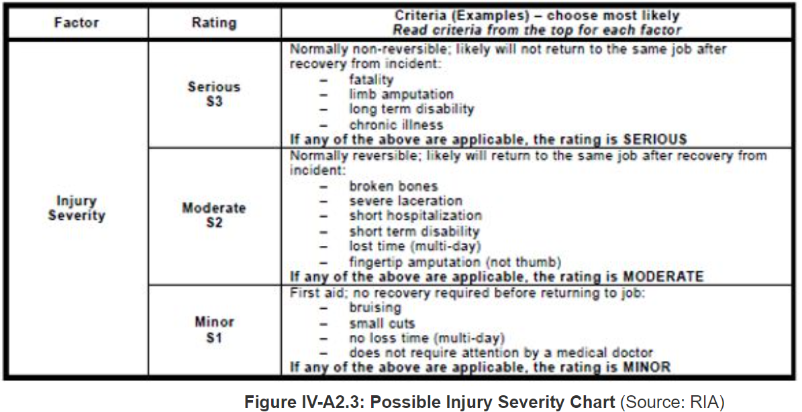
Risk Assessment - OTM Sec. IV: Ch. 4
Notes:
[Hudson]

Slide 22
Manufacturability
Nearly all components within the inmoov robot are widely accessible.
The design requires a 3D printer for the physical structure.
The design is easily manufactured and most of the cost build up comes from the motors/hardware that the robot needs for manipulation.
Mounting fixture design is made of common materials, and can be recycled easily.
Notes:
[Hudson]

Slide 23
Sustainability
Sustainable Design
Parts are easily replaceable (3D printed or OTS)
Low maintenance
Sufficient records kept to reproduce any single part of project in the future.
Reusable Materials
All electronics can be repurposed.
Dolly and post can be repurposed.
Fasteners can be recycled.
Notes:
[Hudson]

Slide 24
Budget
Notes:
[Chase]
Show what we have purchased and how much

Slide 25
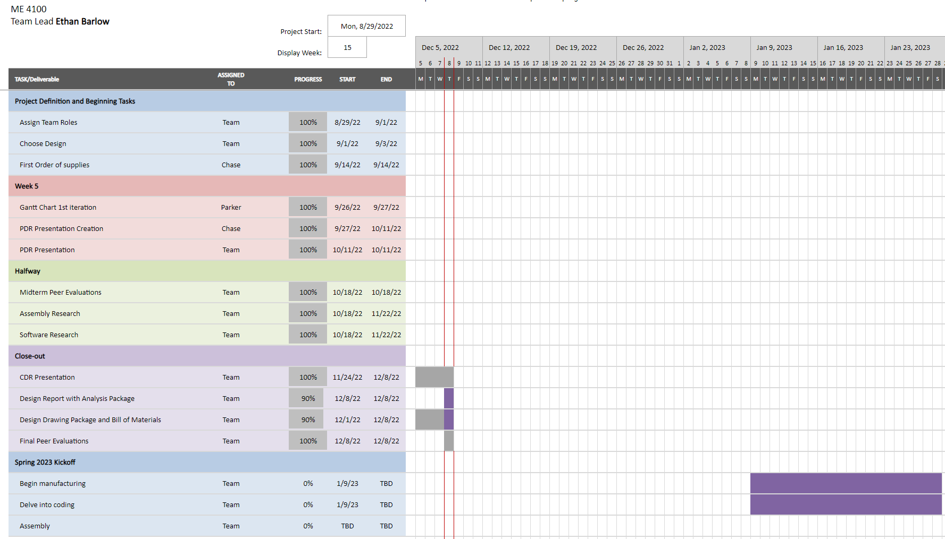
Gantt Chart
Notes:
[Parker]
This is how we kept track of deadlines and remained on track.

Slide 26
Closing remarks
Notes:
[Ethan]
This has been a very challenging but very fulfilling senior project. We hope that you’ve enjoyed our CDR and we hope to have some really awesome results for you in the spring. We also plan on presenting at the spring symposium for the office of undergraduate research either a poster or oral presentation. We may also produce a journal paper down the road!

